Slide 1
Big Mountain Resort Pricing Strategy
Gabriela Rivera

Slide 2
The problem
Company
Context
Problem statement
Big Mountain Resort in Montana hosts around 350,000 people throughout their winter season. In efforts to expand their accessible terrain, they have recently installed an additional chair lift. This project has increased their operating costs for the current season by $1.5M.
They would like a data-driven strategy for accommodating this new expense through cost-cutting measures, charging a premium ticket price, and/or capitalizing on their current facilities.
How can Big Mountain Resort optimize costs by capitalizing on their facilities, and increase revenue through a premium ticket price resulting in an extra $1.5M to go towards operating costs as a result of the installation of their new chair lift over this next season?

Slide 3
Key Findings
Price Optimization
Mean Absolute Error
Profitability Enhancement
Our model suggests that Big Mountain resort can increase the adult weekend ticket price from $81 to $95.87, indicating room for an increase in revenue.
With an expected mean absolute error of $10.39, the pricing model provides a reliable estimation, ensuring minimal deviation from the projected revenue.
The updated pricing strategy aims to optimize revenue streams, leading to improved profitability for Big Mountain resort.

Slide 4
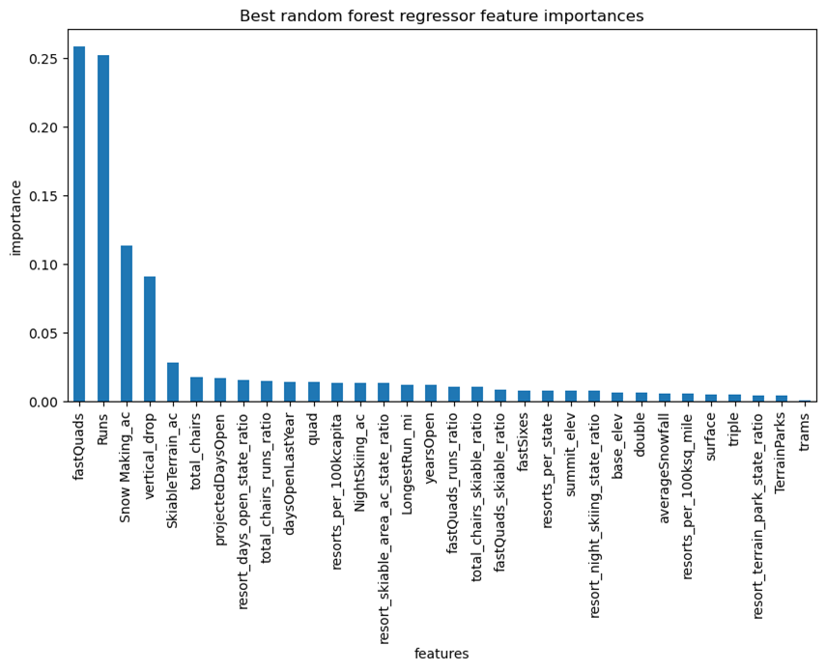
Modeling Results and Analysis
Feature importance output from our final forest regressor model.

Slide 5
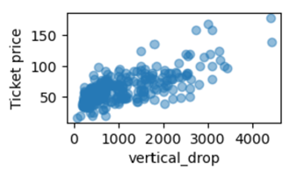
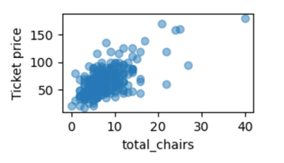
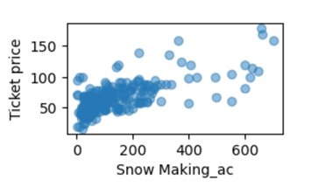
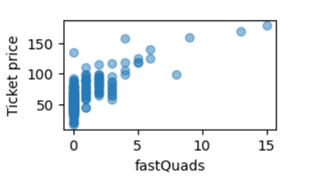
Positive features contributing to ticket price

Slide 6
Results
Resource Allocation: By implementing the pricing model, Big Mountain can allocate resources more effectively, ensuring efficient utilization and maximizing returns.
Competitive Advantage: The proposed pricing strategy gives Big Mountain a competitive edge in the market by offering a balance between affordability and value, attracting more customers.

Slide 7
Future Improvements
To further enhance the resort's appeal, we recommend adding a new run, increasing the vertical drop by 150 feet, and installing an additional chair lift, providing additional value to visitors and increasing revenue potential.

